Slide 1


Slide 2
PART I
My Top Movies watched in 2022

Slide 3
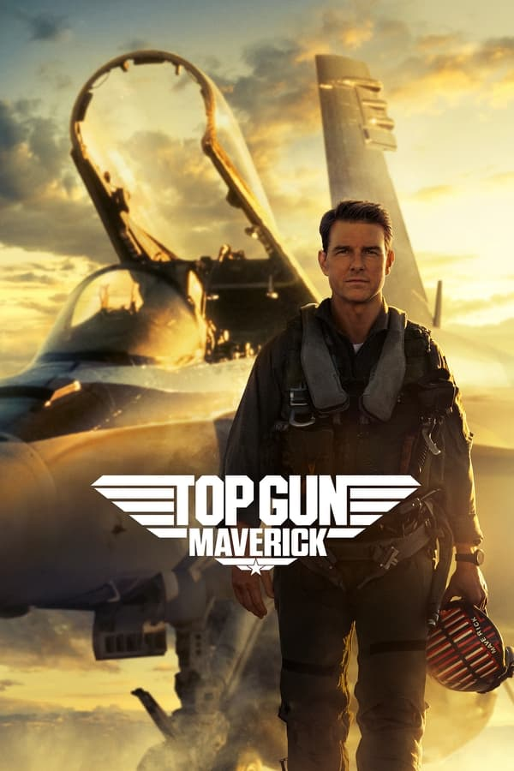

Top Gun: Maverick
“Feel the need... The need for speed.”
05/27/2022 • Action, Drama • 2h 11m

Slide 4
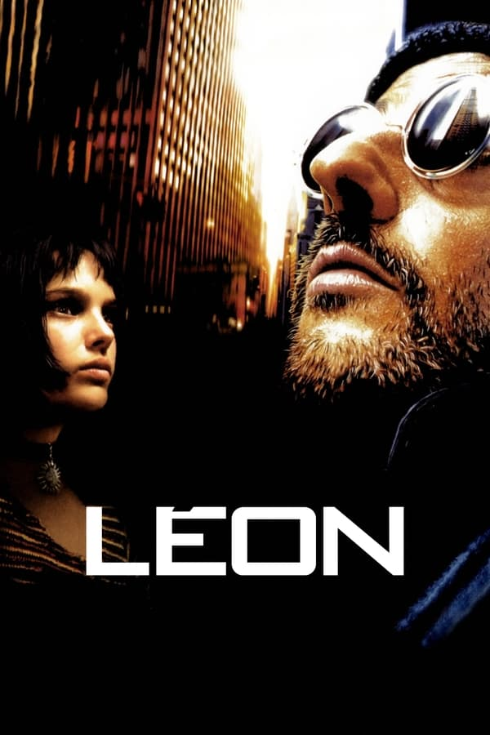

Léon: The Professional
“If you want a job done well, hire a professional.”
11/18/1994 • Crime, Drama, Action • 1h 51m

Slide 5


V for Vendetta
“People should not be afraid of their governments. Governments should be afraid of their people.”
03/17/2006 • Action, Thriller, Science Fiction • 2h 12m

Slide 6
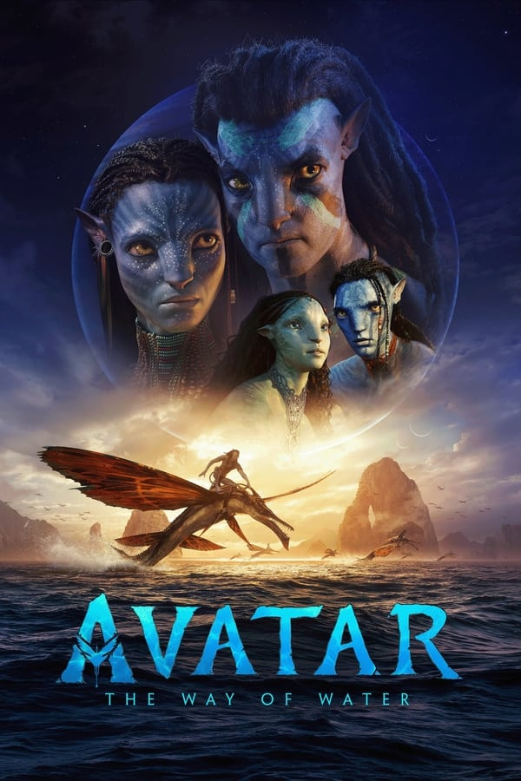

Avatar: The Way of Water
“Return to Pandora.”
12/16/2022 • Science Fiction, Adventure, Action • 3h 12m

Slide 7
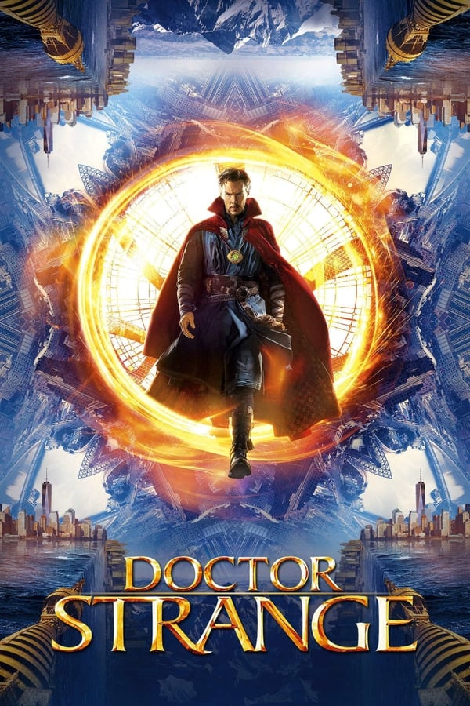

Doctor Strange
“The impossibilities are endless.”
11/04/2016 • Action, Adventure, Fantasy • 1h 55m

Slide 8
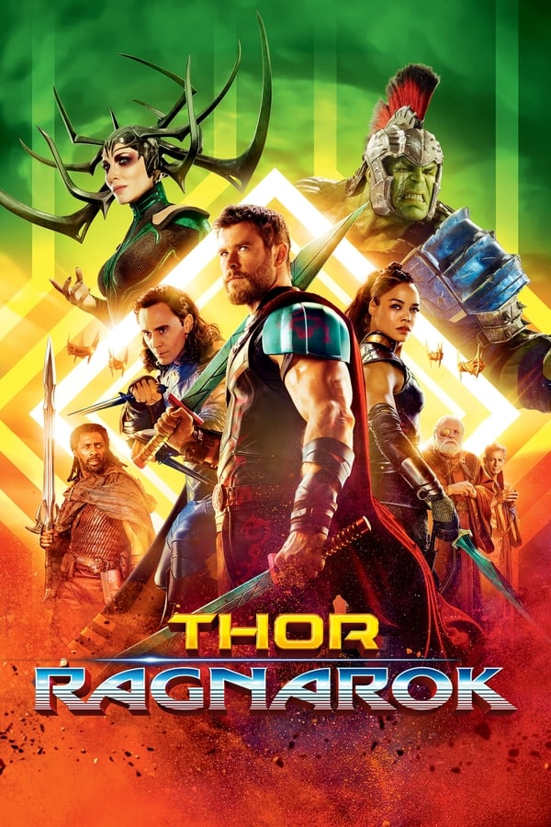

Thor: Ragnarok
“No Hammer. No Problem.”
11/03/2017 • Action, Adventure, Fantasy • 2h 11m

Slide 9
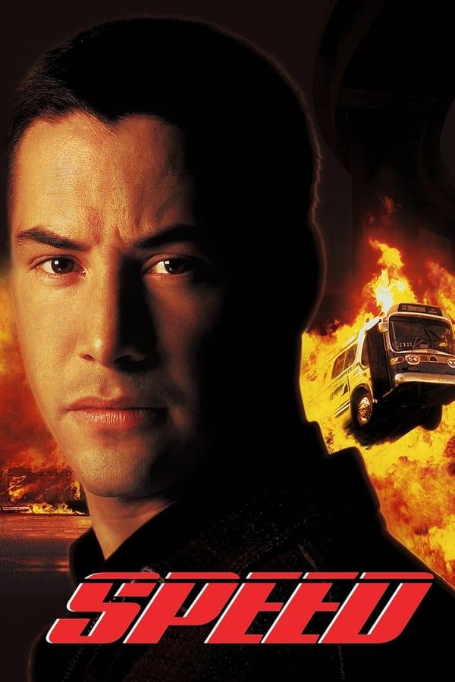

Speed
“Get ready for rush hour.”
06/09/1994 • Action, Adventure, Crime • 1h 56m

Slide 10


Forrest Gump
“The world will never be the same once you've seen it through the eyes of Forrest Gump.”
07/06/1994 • Comedy, Drama, Romance • 2h 22m

Slide 11
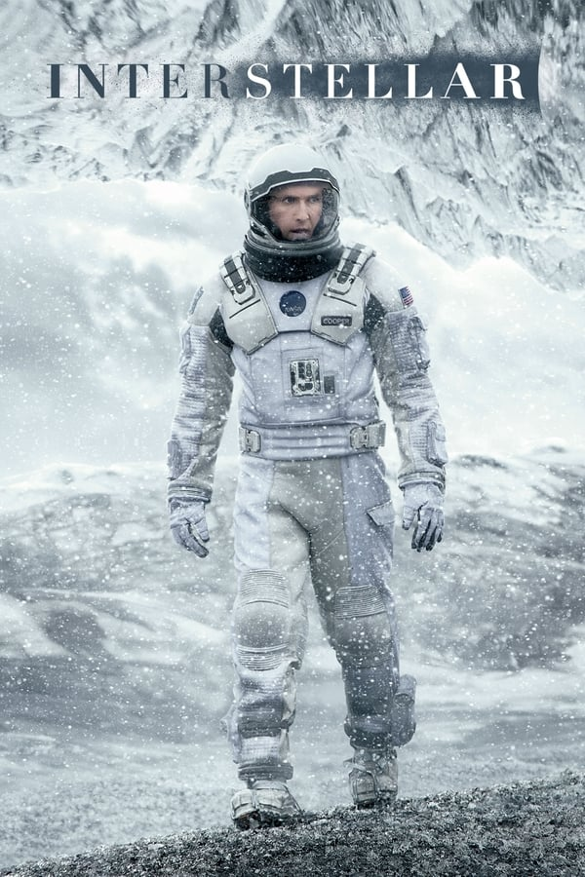

Interstellar
“Mankind was born on Earth. It was never meant to die here.”
11/07/2014 • Adventure, Drama, Science Fiction • 2h 49m

Slide 12
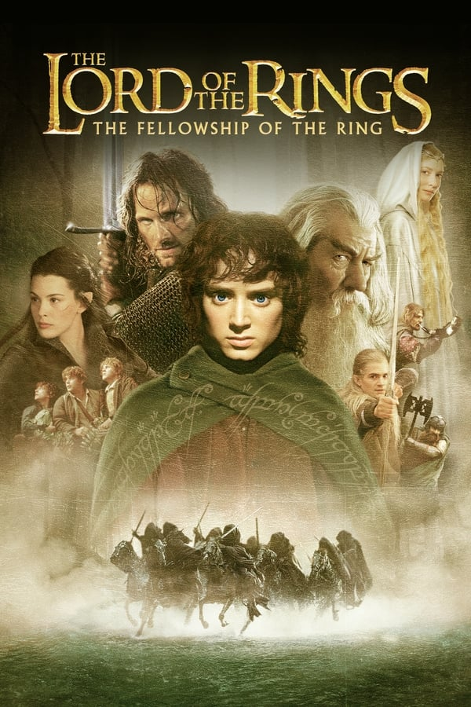
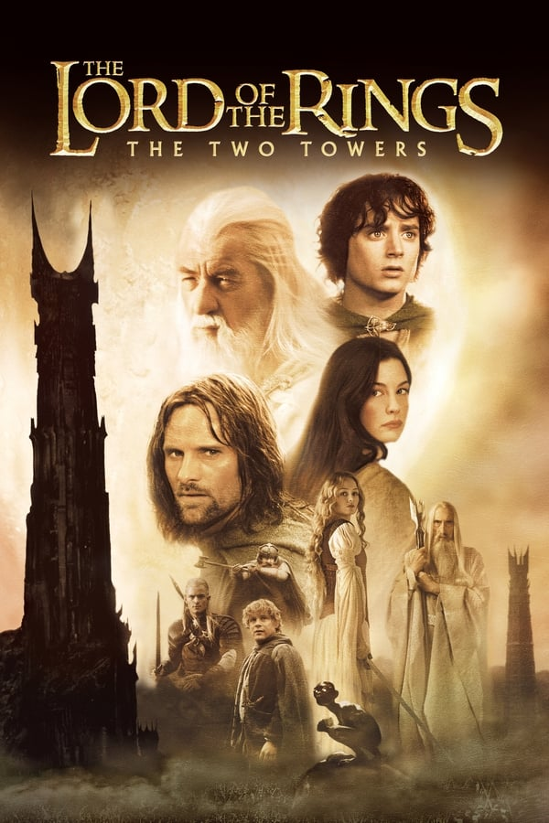
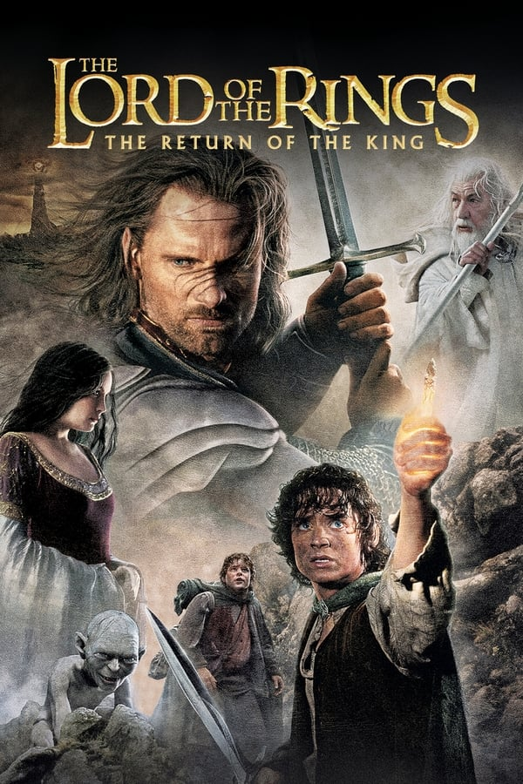

The Lord of the Rings trilogy
Rewatched but still on top!
2001 - 2003 • Adventure, Fantasy, Action • 9h 19m

Slide 14
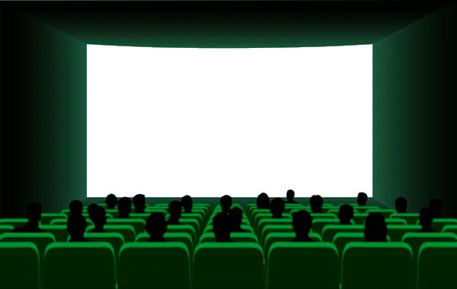
PART II
My Top Series watched in 2022

Slide 15
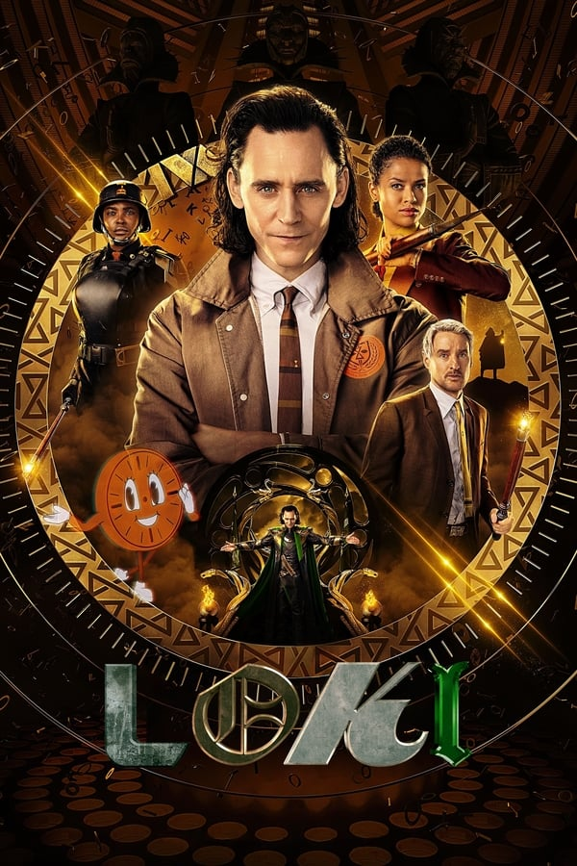
Loki
“Loki's time has come.”
2021 • Drama, Science Fiction, Fantasy • ≈ 4h 51m

Slide 16
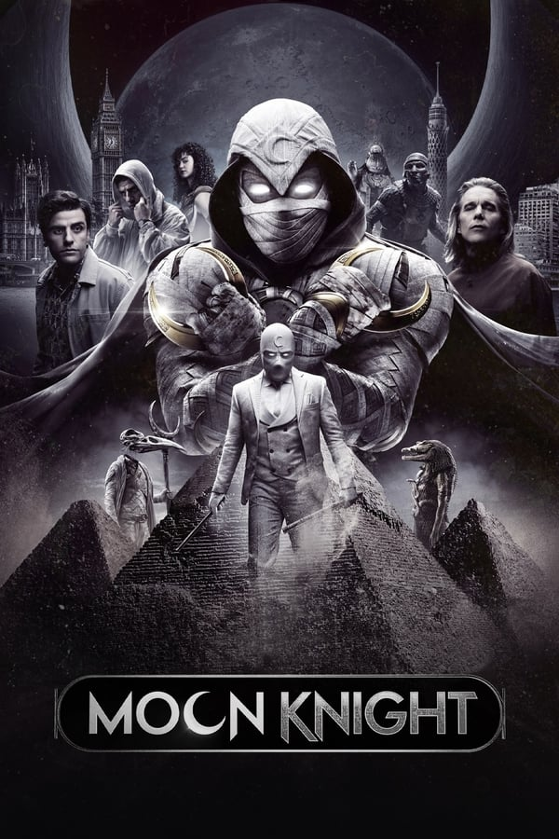
Moon Knight
“Embrace the chaos.”
2022 • Action, Adventure, Fantasy • ≈ 5h 2m

Slide 17
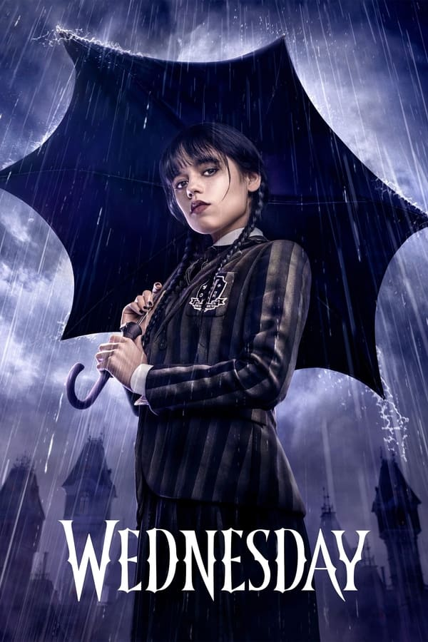
Wednesday
“The suspense will kill you.”
2022 • Fantasy, Mystery, Comedy • ≈ 6h 53m

Slide 18
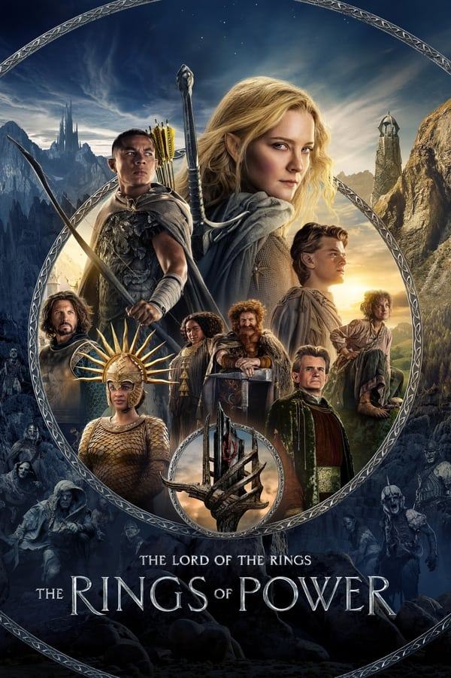
The Lord of the Rings:The Rings of Power
“Journey to Middle-earth.”
2022 • Fantasy, Action, Adventure • ≈ 9h 17m

Slide 19
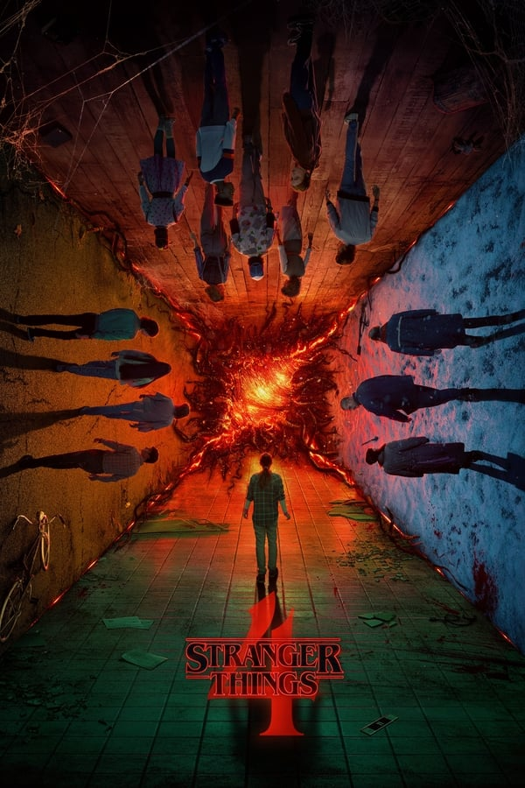
Stranger Things
Season 4
“Every ending has a beginning.”
2022 • Drama, Fantasy, Mystery • ≈ 13h 2m

Slide 21
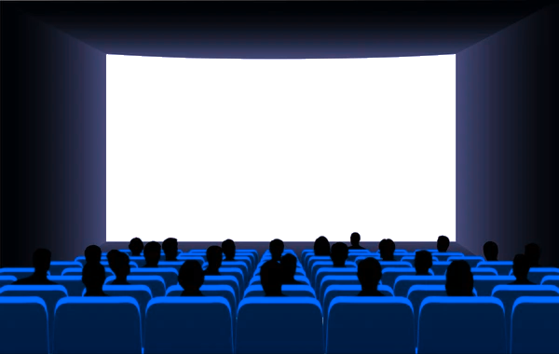
PART III
My Top Actors & Actress in 2022

Slide 22
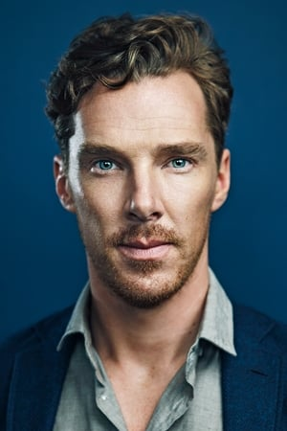
Benedict Cumberbatch
Watched in 2022:
Doctor Strange (Dr. Stephen Strange)
Doctor Strange in the Multiverse of Madness (Dr. Stephen Strange)
The Imitation Game (Alan Turing)
Thor: Ragnarok (Dr. Stephen Strange)

Slide 23
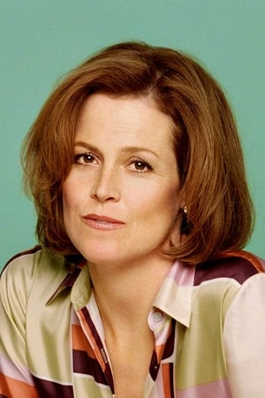
Sigourney Weaver
Watched in 2022:
Aliens (Lt. Ellen Louise Ripley)
Alien³ (Lt. Ellen Louise Ripley)
Alien Resurrection (Ripley 8)
Avatar (Dr. Grace Augustine)
Avatar: The Way of Water (Kiri)

Slide 24
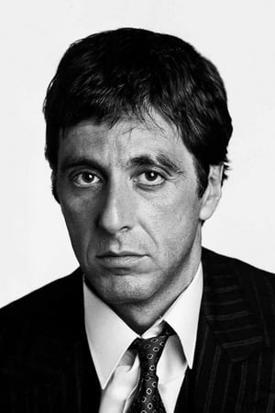
Al Pacino
Watched in 2022:
The Godfather (Don Michael Corleone)
The Godfather Part II (Don Michael Corleone)
The Godfather Part III (Michael Corleone)
The Devil's Advocate (John Milton)
Heat (Lt. Vincent Hanna)
Donnie Brasco (Benjamin 'Lefty' Ruggiero)

Slide 25
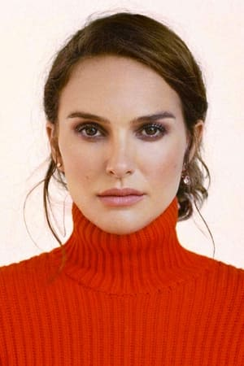
Natalie Portman
Watched in 2022:
V for Vendetta (Evey Hammond)
Léon: The Professional (Mathilda Lando)
Thor (Jane Foster)
Thor: The Dark World (Jane Foster)
Thor: Love and Thunder (Jane Foster / The Mighty Thor)
Mars Attacks! (Taffy Dale)
Heat (Lauren Gustafson)

Slide 26
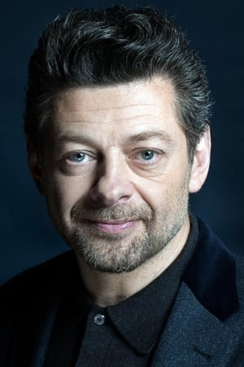
Andy Serkis
Watched in 2022:
The Lord of the Rings: The Fellowship of the Ring (Gollum)
The Lord of the Rings: The Two Towers (Gollum)
The Lord of the Rings: The Return of the King (Gollum)
The Batman (Alfred Pennyworth)
Star Wars: Andor (Kino Loy)

Slide 27
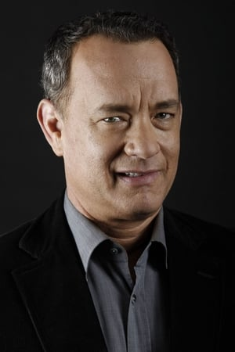
Tom Hanks
Watched in 2022:
Forrest Gump (Forrest Gump)
Cast Away (Chuck Noland)
The Da Vinci Code (Robert Langdon)
Angels & Demons (Robert Langdon)
Inferno (Robert Langdon)
Catch Me If You Can (Carl Hanratty)
The Circle (Eamon Bailey)

Slide 28
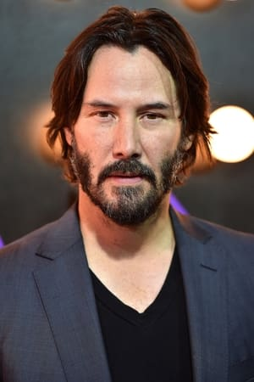
Keanu Reeves
Watched in 2022:
John Wick (John Wick)
John Wick: Chapter 2 (John Wick)
John Wick: Chapter 3 - Parabellum (John Wick)
The Matrix Resurrections (Thomas A. Anderson / Neo)
Speed (Jack Traven)
The Devil's Advocate (Kevin Lomax)
Constantine (John Constantine)
Point Break (Johnny Utah)

Slide 29
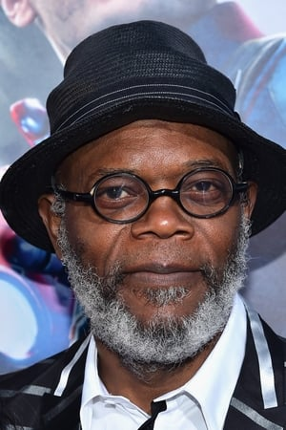
Samuel L. Jackson
Watched in 2022:
Pulp Fiction (Jules Winnfield)
Kingsman: The Secret Service (Valentine)
Captain America: The Winter Soldier (Nick Fury)
The Hitman's Bodyguard (Darius Kincaid)
Hitman's Wife's Bodyguard (Darius Kincaid)
Unbreakable (Elijah Price)

Slide 30
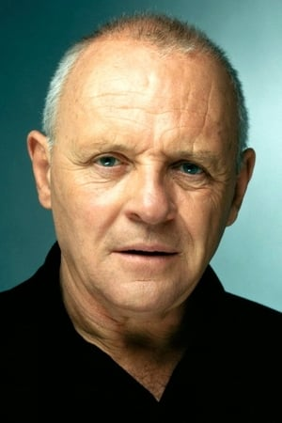
Anthony Hopkins
Watched in 2022:
The Silence of the Lambs (Dr. Hannibal Lecter)
Hannibal (Dr. Hannibal Lecter)
Red Dragon (Hannibal Lecter)
Thor (Odin)
Thor: The Dark World (Odin)
Thor: Ragnarok (Odin)
Fracture (Theodore Crawford)
The Edge (Charles Morse)
RED 2 (Bailey)

Slide 31
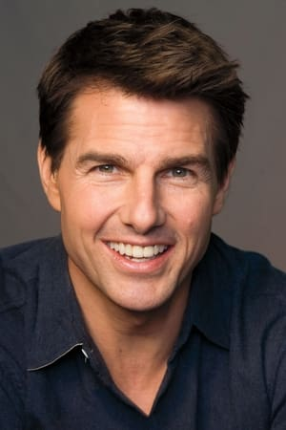
Tom Cruise
Watched in 2022:
Top Gun (Lt. Pete 'Maverick' Mitchell)
Top Gun: Maverick (Capt. Pete 'Maverick' Mitchell)
Mission: Impossible - Ghost Protocol (Ethan Hunt)
Mission: Impossible - Rogue Nation (Ethan Hunt)
Mission: Impossible - Fallout (Ethan Hunt)
Edge of Tomorrow (Maj. William 'Bill' Cage)
Oblivion (Jack)
Jack Reacher as (Jack Reacher)
The Last Samurai (Nathan Algren)

Slide 33

PART IV
My Top Directors in 2022

Slide 34
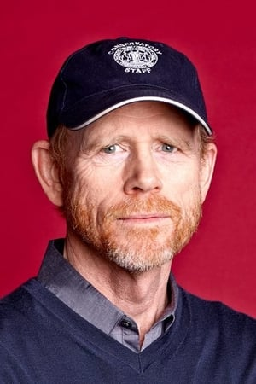
Ron Howard
Watched in 2022:
The Da Vinci Code
Angels & Demons
Inferno
Willow
How the Grinch Stole Christmas

Slide 35
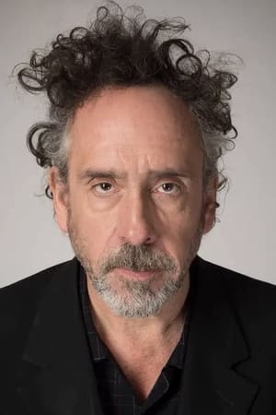
Tim Burton
Watched in 2022:
Wednesday
Beetlejuice
Corpse Bride
Mars Attacks!

Slide 36
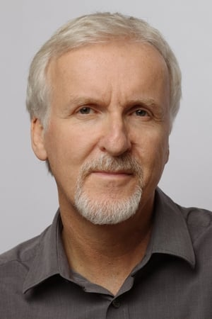
James Cameron
Watched in 2022:
Avatar
Avatar: The Way of Water
Aliens

Slide 37
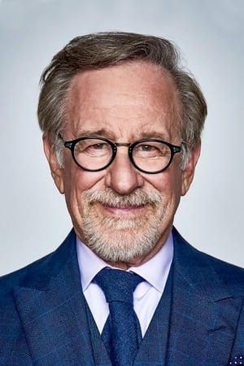
Steven Spielberg
Watched in 2022:
Ready Player One
Catch Me If You Can
Raiders of the Lost Ark
Indiana Jones and the Temple of Doom

Slide 38
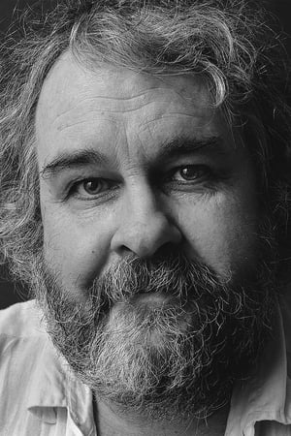
Peter Jackson
Watched in 2022:
The Lord of the Rings: The Fellowship of the Ring
The Lord of the Rings: The Two Towers
The Lord of the Rings: The Return of the King

Slide 40






The pictures of movies, series and artists, informations come from The Movie Database.
The background image and those of the medals come from Dreamstime.
Credits
Music by Mu Hanz.
The heading image on the first slide was created with FlamingText.
Thanks to MoviesFad and SeriesFad for the management (listing).

Slide 41
Thanks for all these films, series
also those that have not been classified in these tops.
See you next year for My CineTop 2023 !

